Slide 1


Powering Future Industries
SILK ROUTE
MATERIALS
Connecting Asia to Middle East & Africa
UAE • Hong Kong • Shanghai

Slide 2




Who We Are
Bridging Three Continents Through Expertise and Experience
Finance Expertise
Logistics Mastery
Industry Experience
Strategic capital allocation and market intelligence to identify emerging opportunities in next-generation industries.
Deep supply chain knowledge connecting manufacturing hubs in Asia to growing markets in Middle East and Africa.
Hands-on understanding of renewable energy, electric vehicles, and advanced manufacturing sectors.
Geographic Advantage
China • Turkey • UAE
Positioned at the intersection of the world's fastest-growing industrial corridors.
"We leverage decades of combined experience to serve as the trusted bridge for next-generation industrial products flowing from Asia to emerging markets."

Slide 3





Vision & Mission
Empowering Sustainable Growth Across Continents
Our Vision
To become the leading facilitator of next-generation industrial solutions, connecting Asian innovation with Middle Eastern and African markets, while driving sustainable economic development across three continents.
Our Mission
Connect
Enable
Accelerate
Support
Bridge manufacturers in China with distributors and end-users in Middle East and Africa through efficient supply chain solutions.
Provide access to cutting-edge electric vehicle components, renewable energy systems, and energy storage technologies.
Fast-track the adoption of sustainable industrial solutions in emerging markets.
Deliver comprehensive aftermarket services and technical expertise to ensure long-term success.
Core Values
Innovation
Reliability
Sustainability
Partnership

Slide 4

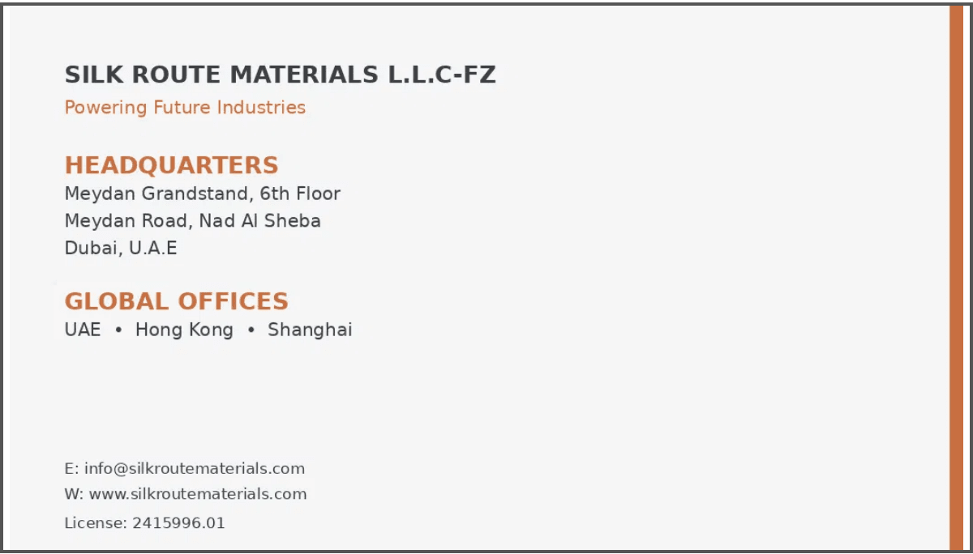
Our Focus Areas
Three Strategic Pillars Driving Future Industries
01
02
03
EV Ecosystem
Renewable Energy
New Energy Components
Complete tier-1 supply chain solutions for EV aftermarket and original parts from leading Chinese manufacturers.
Solar panels, wind energy components, and integrated renewable power solutions for commercial and industrial applications.
Advanced battery storage systems, EV charging infrastructure, and energy management technologies.
Market Opportunity
$180+ Billion Investment
The Middle East and Africa region is undergoing a massive transformation in renewable energy and EV infrastructure through 2030.

Slide 5

Electric Vehicle Supply Chain Excellence
Comprehensive EV Parts and Aftermarket Solutions from China
Tier-1 Chinese EV Components
Why Chinese EV Supply Chain
Battery packs and battery management systems (BMS)
Electric motors and power electronics
60%
75%
Charging cables and connectors
Thermal management systems
Global EV Production
Battery Manufacturing Capacity
Interior and exterior components
Unmatched scale, innovation, and cost efficiency driving the global electric vehicle revolution.
Aftermarket Advantages
Direct relationships with leading Chinese EV manufacturers
Quality-certified components meeting international standards
Competitive pricing through optimized logistics
Technical support and warranty services
Fast delivery to UAE, Middle East, and African markets

Slide 6





Renewable Energy Solutions
Powering the Clean Energy Transition
Solar Energy Systems
Wind Energy Components
Applications
Regional Advantage
•
Commercial & industrial facilities
•
High-efficiency photovoltaic panels
•
Wind turbine components & spare parts
High solar irradiation in the Middle East & Africa makes renewables economically compelling.
•
Remote power for mining and energy sites
•
Solar inverters & mounting systems
•
Control systems & monitoring
•
Agricultural and rural electrification
•
Turnkey solar installations for commercial & industrial clients
•
Maintenance & technical support
•
Utility-scale renewable farms
•
Off-grid & hybrid solar solutions

Slide 7




New Energy Components
Advanced Energy Storage and Charging Infrastructure
Battery Energy Storage (BESS)
EV Charging Infrastructure
Market Growth
$500 Billion
•
Lithium-ion battery storage for grid stabilization
•
Level 2 and DC fast charging stations
•
Commercial and industrial energy storage solutions
•
Smart charging management systems
Global battery storage market expected value by 2030, with MEA as a key growth region.
•
Integration with renewable energy sources
•
Fleet charging solutions for commercial operators
Energy Management
•
Smart grid integration technologies
•
Load balancing and demand response systems
•
Energy monitoring and optimization software

Slide 8

Where We Operate
Strategic Locations Connecting Three Continents
Shanghai
Hong Kong
Dubai
Sourcing & Quality Hub
Finance & Trade Center
Headquarters (UAE)
•
Direct access to manufacturing base
•
International trade and finance hub
•
Middle East and Africa market gateway
•
Quality control and supplier relationships
•
Supply chain management center
•
Distribution and warehousing facilities
•
Product sourcing and logistics coordination
•
Regional coordination and customer service
•
Customer engagement and technical support
Logistics Advantage
40% Faster • 25% Cheaper
Strategic positioning reduces delivery times and costs compared to traditional import channels.

Slide 9







Why Choose Silk Route Materials
Your Trusted Partner for Next-Generation Industrial Solutions
01
02
03
Direct Manufacturer Relationships
Quality Assurance
Logistics Expertise
Rigorous QC and international certifications to ensure reliable performance.
Optimized end‑to‑end logistics covering customs, shipping, and last‑mile delivery.
Partnerships with tier‑1 Chinese suppliers for authentic products and competitive pricing.
04
05
06
Technical Support
Market Knowledge
Financial Flexibility
In‑house engineers provide installation guidance and ongoing maintenance support.
Deep understanding of Middle Eastern and African regulations and market dynamics.
Flexible payment terms and trade‑finance options to support your cash flow.

Slide 10

Let's Connect
Partner with Us to Power Your Future
Next Steps
Get Started Today
01
Share Requirements
Website
Contact us via email or phone with your project needs.
www.silkroutematerials.com
02
Customized Proposal
Email
Receive a tailored solution within 48 hours.
info@silkroutematerials.com
03
Technical Review
Review specifications and pricing with our experts.
Phone
+90 532 564 45 63
04
Partnership
Begin seamless delivery and ongoing support.
Silk Route Materials • Powering Future Industries

